Slide 1
Science in School ⏐ Issue 40: Summer 2017 ⏐ www.scienceinschool.org
Epidemics on Networks
Supporting material for:
Kucharski A et al. (2017) Disease dynamics: understanding the spread of diseases. Science in School 40: 52–56. www.scienceinschool.org/2017/issue40/diseasedynamics
Notes:
Summary from VC2: results from trial survey; cholera; spatial spread model

Slide 2
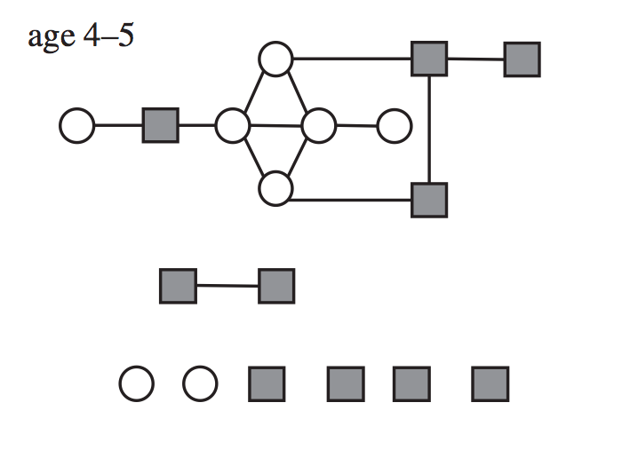
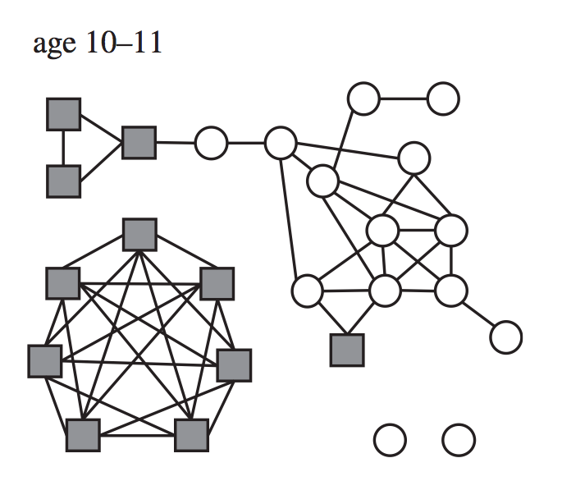
Science in School ⏐ Issue 40: Summer 2017 ⏐ www.scienceinschool.org
Social networks
Age 4–5
Age 10–11
Supporting material for:
Kucharski A et al. (2017) Disease dynamics: understanding the spread of diseases. Science in School 40: 52–56. www.scienceinschool.org/2017/issue40/diseasedynamics

Slide 3
Science in School ⏐ Issue 40: Summer 2017 ⏐ www.scienceinschool.org
How does an epidemic spread on a network?
Supporting material for:
Kucharski A et al. (2017) Disease dynamics: understanding the spread of diseases. Science in School 40: 52–56. www.scienceinschool.org/2017/issue40/diseasedynamics
Notes:
c.f. “The Network Disease” from VC1.

Slide 4
Science in School ⏐ Issue 40: Summer 2017 ⏐ www.scienceinschool.org
How does an epidemic spread on a network?
Day 1
Everyone starts off susceptible, apart from one infected person
Supporting material for:
Kucharski A et al. (2017) Disease dynamics: understanding the spread of diseases. Science in School 40: 52–56. www.scienceinschool.org/2017/issue40/diseasedynamics
Notes:
c.f. “The Network Disease” from VC1.

Slide 5
Science in School ⏐ Issue 40: Summer 2017 ⏐ www.scienceinschool.org
How does an epidemic spread on a network?
Day 2
• Go round infected person’s contacts in turn
Supporting material for:
Kucharski A et al. (2017) Disease dynamics: understanding the spread of diseases. Science in School 40: 52–56. www.scienceinschool.org/2017/issue40/diseasedynamics
Notes:
c.f. “The Network Disease” from VC1.

Slide 6
Science in School ⏐ Issue 40: Summer 2017 ⏐ www.scienceinschool.org
How does an epidemic spread on a network?
Day 2
• Go round infected person’s contacts in turn
• Roll dice. If number is 1 or 2, infect that person
Supporting material for:
Kucharski A et al. (2017) Disease dynamics: understanding the spread of diseases. Science in School 40: 52–56. www.scienceinschool.org/2017/issue40/diseasedynamics
Notes:
c.f. “The Network Disease” from VC1.

Slide 7
Science in School ⏐ Issue 40: Summer 2017 ⏐ www.scienceinschool.org
How does an epidemic spread on a network?
Day 2
• Go round infected person’s contacts in turn
• Roll dice. If number is 1 or 2, infect that person
Supporting material for:
Kucharski A et al. (2017) Disease dynamics: understanding the spread of diseases. Science in School 40: 52–56. www.scienceinschool.org/2017/issue40/diseasedynamics
Notes:
c.f. “The Network Disease” from VC1.

Slide 8
Science in School ⏐ Issue 40: Summer 2017 ⏐ www.scienceinschool.org
How does an epidemic spread on a network?
Day 2
• Go round infected person’s contacts in turn
• Roll dice. If number is 1 or 2, infect that person
• Continue for all contacts
Supporting material for:
Kucharski A et al. (2017) Disease dynamics: understanding the spread of diseases. Science in School 40: 52–56. www.scienceinschool.org/2017/issue40/diseasedynamics
Notes:
c.f. “The Network Disease” from VC1.

Slide 9
Science in School ⏐ Issue 40: Summer 2017 ⏐ www.scienceinschool.org
How does an epidemic spread on a network?
Day 2
• Go round infected person’s contacts in turn
• Roll dice. If number is 1 or 2, infect that person
• Continue for all contacts
Supporting material for:
Kucharski A et al. (2017) Disease dynamics: understanding the spread of diseases. Science in School 40: 52–56. www.scienceinschool.org/2017/issue40/diseasedynamics
Notes:
c.f. “The Network Disease” from VC1.

Slide 10
Science in School ⏐ Issue 40: Summer 2017 ⏐ www.scienceinschool.org
How does an epidemic spread on a network?
Day 2
• Go round infected person’s contacts in turn
• Roll dice. If number is 1 or 2, infect that person
• Continue for all contacts
Supporting material for:
Kucharski A et al. (2017) Disease dynamics: understanding the spread of diseases. Science in School 40: 52–56. www.scienceinschool.org/2017/issue40/diseasedynamics
Notes:
c.f. “The Network Disease” from VC1.

Slide 11
Science in School ⏐ Issue 40: Summer 2017 ⏐ www.scienceinschool.org
How does an epidemic spread on a network?
Day 2
• Go round infected person’s contacts in turn
• Roll dice. If number is 1 or 2, infect that person
• Continue for all contacts
Supporting material for:
Kucharski A et al. (2017) Disease dynamics: understanding the spread of diseases. Science in School 40: 52–56. www.scienceinschool.org/2017/issue40/diseasedynamics
Notes:
c.f. “The Network Disease” from VC1.

Slide 12
Science in School ⏐ Issue 40: Summer 2017 ⏐ www.scienceinschool.org
How does an epidemic spread on a network?
Day 2
• Go round infected person’s contacts in turn
• Roll dice. If number is 1 or 2, infect that person
• Continue for all contacts
Supporting material for:
Kucharski A et al. (2017) Disease dynamics: understanding the spread of diseases. Science in School 40: 52–56. www.scienceinschool.org/2017/issue40/diseasedynamics
Notes:
c.f. “The Network Disease” from VC1.

Slide 13
Science in School ⏐ Issue 40: Summer 2017 ⏐ www.scienceinschool.org
How does an epidemic spread on a network?
Day 2
• Go round infected person’s contacts in turn
• Roll dice. If number is 1 or 2, infect that person
• Continue for all contacts, then infected person recovers
Supporting material for:
Kucharski A et al. (2017) Disease dynamics: understanding the spread of diseases. Science in School 40: 52–56. www.scienceinschool.org/2017/issue40/diseasedynamics
Notes:
c.f. “The Network Disease” from VC1.

Slide 14
Science in School ⏐ Issue 40: Summer 2017 ⏐ www.scienceinschool.org
How does an epidemic spread on a network?
Day 2
• Go round infected person’s contacts in turn
• Roll dice. If number is 1 or 2, infect that person
• Continue for all contacts, then infected person recovers
Supporting material for:
Kucharski A et al. (2017) Disease dynamics: understanding the spread of diseases. Science in School 40: 52–56. www.scienceinschool.org/2017/issue40/diseasedynamics
Notes:
c.f. “The Network Disease” from VC1.

Slide 15
Science in School ⏐ Issue 40: Summer 2017 ⏐ www.scienceinschool.org
How does an epidemic spread on a network?
Day 3
• Start with two infected people
• For each infected person, roll dice for each contact
Supporting material for:
Kucharski A et al. (2017) Disease dynamics: understanding the spread of diseases. Science in School 40: 52–56. www.scienceinschool.org/2017/issue40/diseasedynamics
Notes:
c.f. “The Network Disease” from VC1.

Slide 16
Science in School ⏐ Issue 40: Summer 2017 ⏐ www.scienceinschool.org
How does an epidemic spread on a network?
Day 3
• Start with two infected people
• For each infected person, roll dice for each contact
Supporting material for:
Kucharski A et al. (2017) Disease dynamics: understanding the spread of diseases. Science in School 40: 52–56. www.scienceinschool.org/2017/issue40/diseasedynamics
Notes:
c.f. “The Network Disease” from VC1.

Slide 17
Science in School ⏐ Issue 40: Summer 2017 ⏐ www.scienceinschool.org
How does an epidemic spread on a network?
Day 3
• Start with two infected people
• For each infected person, roll dice for each contact
Supporting material for:
Kucharski A et al. (2017) Disease dynamics: understanding the spread of diseases. Science in School 40: 52–56. www.scienceinschool.org/2017/issue40/diseasedynamics
Notes:
c.f. “The Network Disease” from VC1.

Slide 18
Science in School ⏐ Issue 40: Summer 2017 ⏐ www.scienceinschool.org
How does an epidemic spread on a network?
Day 3
• Start with two infected people
• For each infected person, roll dice for each contact
Supporting material for:
Kucharski A et al. (2017) Disease dynamics: understanding the spread of diseases. Science in School 40: 52–56. www.scienceinschool.org/2017/issue40/diseasedynamics
Notes:
c.f. “The Network Disease” from VC1.

Slide 19
Science in School ⏐ Issue 40: Summer 2017 ⏐ www.scienceinschool.org
How does an epidemic spread on a network?
Day 3
• Start with two infected people
• For each infected person, roll dice for each contact
Supporting material for:
Kucharski A et al. (2017) Disease dynamics: understanding the spread of diseases. Science in School 40: 52–56. www.scienceinschool.org/2017/issue40/diseasedynamics
Notes:
c.f. “The Network Disease” from VC1.

Slide 20
Science in School ⏐ Issue 40: Summer 2017 ⏐ www.scienceinschool.org
How does an epidemic spread on a network?
Day 3
• Start with two infected people
• For each infected person, roll dice for each contact
Supporting material for:
Kucharski A et al. (2017) Disease dynamics: understanding the spread of diseases. Science in School 40: 52–56. www.scienceinschool.org/2017/issue40/diseasedynamics
Notes:
c.f. “The Network Disease” from VC1.

Slide 21
Science in School ⏐ Issue 40: Summer 2017 ⏐ www.scienceinschool.org
How does an epidemic spread on a network?
Day 3
• Start with two infected people
• For each infected person, roll dice for each contact
Supporting material for:
Kucharski A et al. (2017) Disease dynamics: understanding the spread of diseases. Science in School 40: 52–56. www.scienceinschool.org/2017/issue40/diseasedynamics
Notes:
c.f. “The Network Disease” from VC1.

Slide 22
Science in School ⏐ Issue 40: Summer 2017 ⏐ www.scienceinschool.org
How does an epidemic spread on a network?
Day 3
• Start with two infected people
• For each infected person, roll dice for each contact
Supporting material for:
Kucharski A et al. (2017) Disease dynamics: understanding the spread of diseases. Science in School 40: 52–56. www.scienceinschool.org/2017/issue40/diseasedynamics
Notes:
c.f. “The Network Disease” from VC1.

Slide 23
Science in School ⏐ Issue 40: Summer 2017 ⏐ www.scienceinschool.org
How does an epidemic spread on a network?
Day 3
• Start with two infected people
• For each infected person, roll dice for each contact
Supporting material for:
Kucharski A et al. (2017) Disease dynamics: understanding the spread of diseases. Science in School 40: 52–56. www.scienceinschool.org/2017/issue40/diseasedynamics
Notes:
c.f. “The Network Disease” from VC1.

Slide 24
Science in School ⏐ Issue 40: Summer 2017 ⏐ www.scienceinschool.org
How does an epidemic spread on a network?
Day 3
• Start with two infected people
• For each infected person, roll dice for each contact
Supporting material for:
Kucharski A et al. (2017) Disease dynamics: understanding the spread of diseases. Science in School 40: 52–56. www.scienceinschool.org/2017/issue40/diseasedynamics
Notes:
c.f. “The Network Disease” from VC1.

Slide 25
Science in School ⏐ Issue 40: Summer 2017 ⏐ www.scienceinschool.org
How does an epidemic spread on a network?
Day 3
• Start with two infected people
• For each infected person, roll dice for each contact
Supporting material for:
Kucharski A et al. (2017) Disease dynamics: understanding the spread of diseases. Science in School 40: 52–56. www.scienceinschool.org/2017/issue40/diseasedynamics
Notes:
c.f. “The Network Disease” from VC1.

Slide 26
Science in School ⏐ Issue 40: Summer 2017 ⏐ www.scienceinschool.org
How does an epidemic spread on a network?
Day 3
• Start with two infected people
• For each infected person, roll dice for each contact
Supporting material for:
Kucharski A et al. (2017) Disease dynamics: understanding the spread of diseases. Science in School 40: 52–56. www.scienceinschool.org/2017/issue40/diseasedynamics
Notes:
c.f. “The Network Disease” from VC1.

Slide 27
Science in School ⏐ Issue 40: Summer 2017 ⏐ www.scienceinschool.org
How does an epidemic spread on a network?
Day 4
• Start with two infected people
• Continue until epidemic ends
Supporting material for:
Kucharski A et al. (2017) Disease dynamics: understanding the spread of diseases. Science in School 40: 52–56. www.scienceinschool.org/2017/issue40/diseasedynamics
Notes:
c.f. “The Network Disease” from VC1.

